Slide 1
PHP
Hypertext Preprocessor

Slide 2
PHP is a server-side scripting language for creating dynamic and interactive web pages.
  Ie. Code is executed on the server.
A PHP page will generally contain PHP elements with HTML tags and other textual content.
PHP is case sensitive.

Slide 3
Files are saved with “.php” extension.
Every PHP line terminates with a semicolon.
PHP is an Open Source Software (OSS)

Slide 4
<Html>
<body>
<?php
……..
Server
PHP Parser
PHP page
<Html>
<body>
PHP content……..
Request
Database
Response
Client
Plain HTML

Slide 5
When a web browser requests a PHP page from the server, the server calls up the PHP parser. The parser executes all the PHP script instructions on the page, and returns the file to the browser as plain HTML. During this process the PHP parser may also retrieve information from a database.

Slide 6
In order to develop and run PHP web pages three main components are needed:
Web Server
  PHP will work with many of the Web Servers such as IIS. But is most often used with the freely available Apache server.
Database
  PHP supports many databases such as MYSQL, Oracle, Informix, Sybase etc.

Slide 7
PHP Parser
  In order to process PHP script instructions to generate HTML a parser is required.

Slide 8
All PHP code must be included inside one of the following markup tags:
  <?php php code ?>
  <? php code ?>
  <script language=“php”> php code </script>

Slide 9
Example 1
Write a PHP page to print a message

Slide 10
      <html>
      <body>
      <h1>My first PHP page</h1>
      <?php
      echo “<h2>Hello world</h2>”;
      ?>
      </body>
      </html>
Print “Hello World”

Slide 11
echo "<h2><center><font color='Blue' face = 'Arial'>Hello World</font></center></h2>";

Slide 12
Comments
Comments can be added inside a PHP code block by using // and # between single line comments and /* and */ between multi-line comments.

Slide 13
      <html>
      <body>
      <?
      /* Here is an introduction to
      Multi line comments */
      //Here is single line comment
      # Here is another single line comment
      echo “<h2>Hello world</h2>”;
      ?>
      </body>
      </html>

Slide 14
Variables
All variables must begin with a dollar ($) sign followed by a meaningful name.
The name can contain any letter, number or the underscore, but the name cannot begin with a number.
  Eg: $abc
    $my_abc
    $var123

Slide 15
Example:
Write a PHP program to print the value of a variable as HTML

Slide 16
      <html>
      <body>
      <h1> Use of Variables</h1>
      <?php
      $today=“Thursday”;
      echo “<h2>Today is $today</h2>”;
      ?>
      </body>
      </html>

Slide 17
Note:
A variable in PHP can store any type of value (eg: Integer, floating pt, string, boolean etc)

Slide 18
Arrays
The array() function can be used to define an array.
$array_name =array(“value1”, value2”,..);

Slide 19
      <html>
      <body>
      <h1> PHP with array</h1>
      <?php
      $month=array( “July”, “August”);
      $year=array(“2007”, “2008”);
      echo “$month[0], $year[1]”;
      ?>
      </body>
      </html>

Slide 20
An array can also be defined using variable names as array elements.

Slide 21
      <html>
      <body>
      <h1> PHP with array1</h1>
      <?php
      $colors =array(“Fire”=> “Red”, “Sea”=> “Blue”);
      $col = $colors[“Sea”];
      echo “<h2>The Sky is $col<h2>”;
      ?>
      </body>
      </html>

Slide 22
Listing all the array elements
All the array elements can be retrieved by using the PHP in-built function foreach().
foreach( array as variable)

Slide 23
    <html>
    <body>
    <h1>arrays with PHP</h1>
    <?php
    $colors = array("Red", "Blue", "Green", "Yellow");
    foreach($colors as $value)
    {echo "<h2><li>I like $value</li></h2>";
    }
    ?>
    </body>
    </html>

Slide 24
Using Flow Control

Slide 25
If Statement
<html><body>
<h1>using If condition</h1>
<?php
$marks=78;
if($marks>=50)
{ echo "You got $marks"; }
else
{ echo “You failed"; }
?>
</body> </html>

Slide 26
Handling Form Data
A web browser can send data to a web server in different ways such as using a URL, hyperlink or a form.

Slide 27
PHP stores data coming from the browser in built-in variables:
  $_GET[] – When the request is made using the GET method.
  $_POST[] - When the request is made using the POST method.
  $_REQUEST[] - When the request is made using the GET/POST method.

Slide 28
Example
Create a HTML page with a hyperlink to send the following data to the server. Create a PHP page to access this data.
Userid = 1001
Username = abc
Status = off

Slide 29
Sender.html
<html>
<body>
<h1>Sending Data to the Server</h1>
<hr>
<a href = "http://localhost/data1.php?userid=1001&username=abc&status=off"> Click here to send the data
</a>
</body>
</html>

Slide 30
Data1.php
<html><body>
<h1>Receiving data</h1>
<?php
$uid = $_REQUEST["userid"];
$uname = $_REQUEST["username"];
$status = $_REQUEST["status"];
echo "User ID =$uid<br>";
echo "User name =$uname<br>";
echo "Status =$status";
?>
</body>
</html>

Slide 31
Example 2:
Create a HTML page with two hyperlinks to send the following data to the web server. Create a PHP page to access this data and print them in HTML as given below:

Slide 32
Data:
Type = Subject
Choice1 = English
Choice 2 = Maths
Type = Sports
Choice1 =Cricket
Choice 2 = Chess
Output:
Favorite Subject:
English
Maths
Favorite Sports:
Cricket
Chess

Slide 33
<html><body>
<h1> Sending Data</h1>
<hr>
<a href="http://localhost/data2.php?type=subject&choice1=English&choice2=Maths">Your Favorite Subject
</a>
<hr>
<a href="http://localhost/data2.php?type=sport&choice1=Cricket&choice2=Chess">Your Favorite Sport
</a>
</body></html>

Slide 34
<html><body>
<h1>Receive Data</h1>
<?php
$link = $_REQUEST["type"];
$choice1 = $_REQUEST["choice1"];
$choice2 = $_REQUEST["choice2"];
?>
<h2>Favourite <?php echo "$link" ?>
<ol>
<li><?php echo "$choice1" ?></li>
<li><?php echo "$choice2" ?></li></ol>
</body></html>

Slide 35
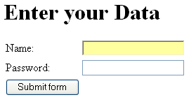
Example 3
Create the following form in HTML. When the user clicks the login button, display the name and password on the same page below the form.

Slide 36
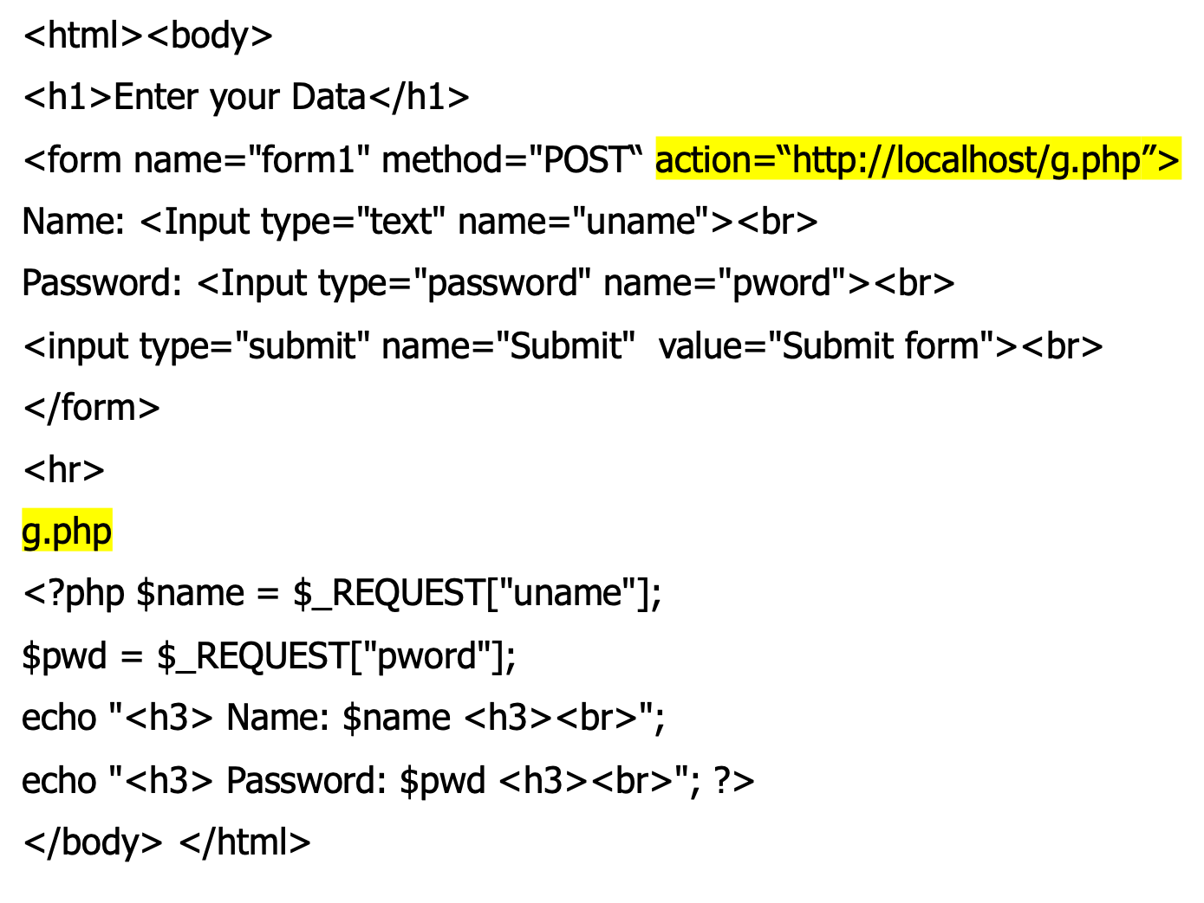

Slide 37
Example 4
Modify this example so that the user name and password will be displayed on a separate page.

Slide 38
Example 5:
Create an HTML form to enter a name and marks of a student. Create a PHP page to access this data and if the student has got marks 50 or above, display the output as “You have Passed and else display the output as “You have Failed”.

Slide 39
marks.html
<html><body>
<h1>Enter Your marks</h1>
<form method="POST" action=“test/marks.php">
Name: <Input type="text" name="sname"> <br>
Marks: <Input type="text" name="marks"> <br>
<input type="SUBMIT" value="Submit">
<input type="RESET" value="Cancel">
</body></html>

Slide 40
marks.php
<html><body>
<h2>Your Results: <br>
<?php
$name=$_REQUEST["sname"];
$marks=$_REQUEST["marks"]; ?>
Name: <? echo "$name"; ?><br>
result:
<? if($marks>='50')
{ echo "You have Passed"; }
else
{ echo "Sorry You have Failed"; } ?>
</body></html>

Slide 41
Example 6:
Create the following form using HTML:
Guest Book
Name
Email
Your Comments:
Sign the Guest Book
Cancel

Slide 42
When the user presses the “sign the guest book” button display the following table with the data entered:
Thank you for signing the guest book
Your Name: | ABC
E-mail: | abc@yahoo.com
Comments: | Your site is great

Slide 43
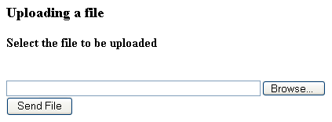
File Uploads
Creating an upload form
Example 1:
create the following form using HTML to upload a file.

Slide 44
Note:
Only POST requests can be used for file uploads.

Slide 45
<html><body>
<h3>Uploading a file</h3>
<h4>Select the file to be uploaded</h4><br>
<form name=“form1” action="http://localhost/uploadfile.php" method="POST" enctype="multipart/form-data">
<input type="file" name="file1" size="50">
<br>
<input type="SUBMIT" name="submit" value="Send File">
</form>
</body></html>

Slide 46
Reading Uploaded Files
Once the files are uploaded the properties of the uploaded file can be accessed using the array $_FILES[].

Slide 47
Example:
$_FILES[“file1”][“name”]
Returns the actual name of the uploaded file.
$_FILES[“file1”][“type”]
Returns the type of file uploaded.
$_FILES[“file1”][“size”]
Returns the size of file uploaded.

Slide 48
File1 -> name of the file control, which is used to refer to the file uploaded.

Slide 49
Example 1:
Write a PHP page to display actual name, file type and size of an uploaded file.

Slide 50
Uploadfile.php
<html><body>
<h2>File information</h2>
<hr>
<?php
$fname=$_FILES["file1"]["name"];
$type=$_FILES["file1"]["type"];
$size=$_FILES["file1"]["size"];
echo "File name: $fname <br>";
echo "File type: $type <br>";
echo "File size: $size <br>";
?>
</body></html>

Slide 51
Note:
when a file is uploaded, PHP stores the file in a temporary folder in the server, with a temporary file name. As soon as the request is over, this file gets deleted from the server.
To keep the file in the server, the file should be moved to a different location in the server.

Slide 52
The temporary filename of the file stored in the server, can be accessed by using:
$_FILES[“file1”][“tmp_name”]
$z=$_FILES[”file1”][“tmp_name”];
echo $z;

Slide 53
To move uploaded files to a different location
move_uploaded_file (temp file name, “new location”);
$v=move_uploaded_file (temp file name, “new location”);
$v=1 $v=0. if($v==1) echo “file success”

Slide 54
Example 2:
Write a PHP page to move to a new location an uploaded file.

Slide 55
<html><body>
<h1><center>Copying uploaded file</center></h1>
<?php
$fname=$_FILES["file1"]["name"];
$ftemp=$_FILES["file1"]["tmp_name"];
$flag=move_uploaded_file($ftemp,"D:/$fname");
if($flag)
{echo "File moved successfully";}
else
{echo " Sorry couldn't move";}
?>
</body></html>

Slide 56
Opening and Closing Files
To read or write to a file, first the file should be opened. In PHP, the function fopen() is used to open the temporary file.
  $fp = fopen(“filename”, “mode”);

Slide 57
fopen() returns a file pointer (an integer value). This value can be used, to work with files.
Mode | Description
r | Open for reading only

Slide 58
fgets() – Read one line of text.
fclose() – Close the temporary file
feof() –
  It is a function that can be used to determine whether the program has reached the end of the file.

Slide 59
Example 3
Write a program to open and read a file using PHP.

Slide 60
<html><body>
<h2>Reading a File</h2>
<?php
$fp=fopen($_FILES["file1"]["tmp_name"],"r");
while(!feof($fp))
{
$text = fgets($fp);
echo "$text <br>"; 1.Create a HTML pgm to Upload Text
} file ?
fclose($fp); 2. Create a php page to read and
?> print the content ?
</body></html>

Slide 61
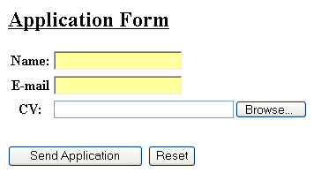
Example 4
Create the following form using HTML.
When the above form is submitted, write a PHP page to display the name, e-mail address and the contents of the CV.

Slide 62
<html><body>
<h2><u>Application Form</u><h2>
<form method="POST" action="http://localhost/file2.php" enctype="multipart/form-data">
Name:<input type="text" name="aname"><br>
E-mail: <input type="text" name="email"><br>
CV:<input type="file" name="file1" size=30><br>
<input type="SUBMIT" name="SUBMIT" value="Send Application">
<input type="RESET" name="RESET” value=“Reset">
</form>
</body></html>

Slide 63
<html><body>
<h2>Data of Applicant</h2>
Name:<?php $name=$_REQUEST["aname"];
echo $name ?><br>
E-mail:<?php $mail=$_REQUEST["email"];
echo $mail ?><br>
<h3><u>CV Details:</u></h3>
<?php $handle = fopen($_FILES["file1"]["tmp_name"],"r");
while(!feof($handle))
{$text = fgets($handle);
echo "$text <br>"; }
fclose($handle); ?>
</body></html>

Slide 64
Creating Files and Folders
Example 1:
Create a folder “testfolder” in the web server root and create the file “test.txt” inside the folder. Also write coding to delete the file.

Slide 65
mkdir(“dirname”) – Creates a Folder
touch(“filename”) – Creates a file if the file does not exists. Returns true if successful.
unlink(“filename”) – Deletes a file. Returns true if successful.

Slide 66
<html><body>
<h3>File Handling<h3>
<hr>
<?php $flag=mkdir("testfolder");
if($flag)
echo "Folder created successfully <br>";
$flag=touch("testfolder/test.txt");
if($flag)
echo "File created <br>";
$flag=unlink("testfolder/test.txt");
if($flag)
echo "File deleted"; ?>
</body></html>

Slide 67
Mode | Description
r | Open for reading only
r+ | Open for reading and writing
w | Open for writing only. If the file does not exists, attempt to create it.
w+ | Open for reading and writing. If the file does not exists, attempt to create it.

